Slide 1
Swift Creek Middle School Bridge to AP Parent Night

Slide 2
What is Bridge to AP?
Advanced Placement (AP)
Advanced high school coursework for potential college credit.
Flexible curriculum with over 37 course offerings.
Offered at all 5 area public high schools.
Builds study skills and higher order thinking.
33% of students who attend college graduate.
76% of students who take 2 or more AP courses graduate.
Develops transcripts for college admissions.

Slide 3
What is Bridge to AP?
Bridge to AP Program
Advanced coursework in specific content areas to provide high school opportunities in middle school.
Develops study skills and higher order thinking in a supportive environment.
Provides “Stretch” opportunities inside and outside of the classroom to enrich student learning.
Creates an environment of deeper learning in specific content areas of interest.
Supports students attempting to challenge themselves in advanced coursework.

Slide 4
What is Bridge to AP?
Advanced classes is English, Math, Science, Social Studies, and Electives.
Designated classes with other Bridge students.
Guest speakers, assemblies, and field trips to support advanced content.
“Stretch” activities and assignments.
Support systems (Tutoring, One on one conferences, course progression discussions) to help develop skills.
Can be taken in pairs- ELA/SS, Math Science, or all 4

Slide 5
Bridge Progressions- English
6th Grade | 7th Grade | 8th Grade
M/J Lang Arts 1 Advanced- Bridge | M/J Lang Arts 2 Advanced- Bridge | M/J Language Arts 3 Advanced- Bridge
M/J Lang Arts 1 Advanced | M/J Lang Arts 2 Advanced | M/J Language Arts 3 Advanced
M/J Language Arts 1 | M/J Language Arts 2 | M/J Language Arts 3

Slide 6
Bridge Courses- English
6th Grade Bridge English/ Language Arts
All 6th grade standards.
Novels, independent reading, and projects to promote critical thinking and reasoning to analyze complex texts.
Increased text-based, expository, and persuasive writing with an emphasis on counterarguments.
Preparing students for high school critical thinking, reasoning, and communication throughout middle school.

Slide 7
Bridge Progressions- Math
6th Grade | 7th Grade | 8th Grade
M/J Accelerated Math Grade 6- Bridge | High School Algebra 1 Honors | High School Geometry Honors
M/J Accelerated Math Grade 6 | M/J Accelerated Math Grade 7 | High School Algebra 1 Honors
M/J Grade 6 Math | M/J Grade 7 Math | M/J Grade 8 Pre-Algebra

Slide 8
Bridge Courses- Math
6th Grade Bridge Math
All 6th grade standards.
Some 7th grade standards in Pre-Algebra.
Pacing, rigor, and collaboration increase in 6th grade Bridge Math.
Preparing students for high school Algebra 1 Honors and/or Geometry in 7th and 8th grade.

Slide 9
Bridge Progressions- Science
6th Grade | 7th Grade | 8th Grade
M/J Advanced Comp Sci 1- Bridge | High School E/S Science Honors | High School Biology Honors
M/J Advanced Comp Sci 1 | M/J Advanced Comp Sci 2 | High School E/S Science Honors
M/J Comp Sci 1 | M/J Comp Sci 2 | M/J Comp Sci 3

Slide 10
Bridge Courses- Science
6th Grade Bridge Comprehensive Science
All 6th grade standards including energy, forces, motion; weather, climate, and Earth systems; Cell, Cell Theory, Human Body, and Genetics.
Students make more connections to the content.
Assignments more independent and group based inquiry.
Student participate in Science Fair.
Preparing students for high school Earth Space Science Honors and/or Biology Honors in 7th and 8th grade.

Slide 11
Bridge Progressions- Social Studies
6th Grade | 7th Grade | 8th Grade
M/J Advanced World History- Bridge | M/J Advanced Civics- Bridge | M/J Advanced US History- Bridge
M/J Advanced World History | M/J Advanced Civics | M/J Advanced US History
M/J World History | M/J Civics | M/J US History

Slide 12
Bridge Courses- Social Studies
6th Grade Bridge World History
All 6th grade standards including ancient world civilizations with an emphasis on geography, government, economics, religion, and cultures.
Students make more connections to the content.
Participation in the historical process through research, thesis creation, and primary/secondary sources.
Opportunity to participate in History Fair.
Preparing students for high school critical thinking, reasoning, and communication throughout middle school.

Slide 13
Benefits of Bridge
Advanced coursework with like-minded students.
Selection of preferred content areas.
Teachers trained to develop critical thinking.
Deeper content knowledge in preparation of future advanced coursework, both in middle and high school.
Educational opportunities inside and outside of the classroom.
8th grade promotion certificate designation/ seal.

Slide 14
Supports for Bridge
Specific curriculum and content experiences to develop an understanding of content area.
Communication between content area teachers to develop overarching skills and progressions.
Individualized meetings and progression plans with teachers and administration.
Tutoring and skill development plans with teachers and older Bridge students.

Slide 15
Clubs and Electives
Clubs | Electives
Black History Brain Bowl | Art
Brain Bowl | Band
Chess | Chorus
FCA | Career/ Technology Education
Debate/ Speech | Culinary Arts
Industry Certifications | Dance
LEGO Robotics | Forensics/ STEM 1/ STEM 2
Math Competitions | Guitar
National Junior Honor Society | Math Competition
Science Olympiad | Orchestra
Spanish | PE
Spelling Bee | SGA/Leadership
Student Government | High School Spanish 1 and 2
Yearbook | Theatre/ Musical Theatre

Slide 16
What’s Next?
Students may participate in Bridge in 3 ways.
English/ Social Studies
Math/ Science
All 4 Core
Students who scored a level 4 or 5 on FAST are encouraged to enroll in Bridge courses.
Students who earned below a 3 on FAST may request Bridge courses.

Slide 17
What’s Next?
Swift Creek will meet with zoned elementary students at their elementary school.
Buck Lake 3/21
Chaires 3/21
WT Moore- TBA
Course registration will occur in paper form.
Buck Lake, Chaires, WT Moore students will visit Swift Creek in May.
6th grade introduction camp 7/21-7/24

Slide 18
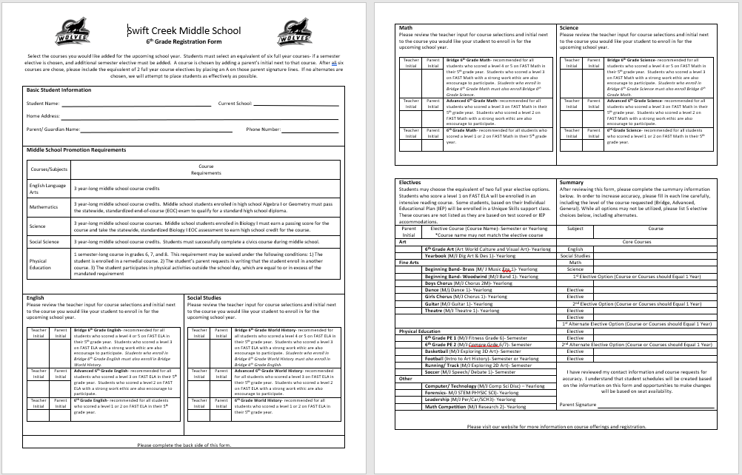

Slide 19
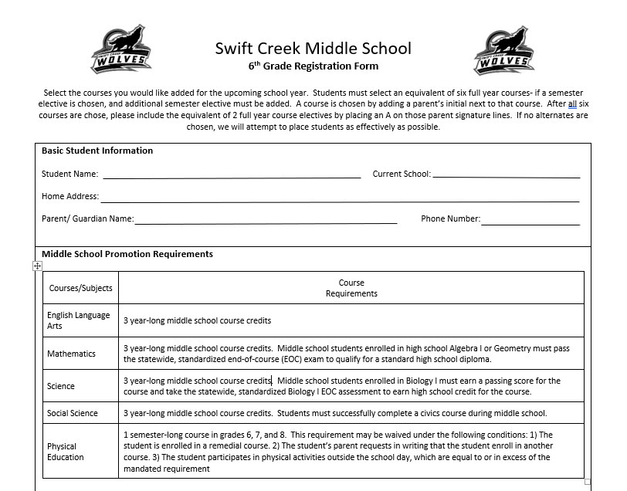

Slide 20
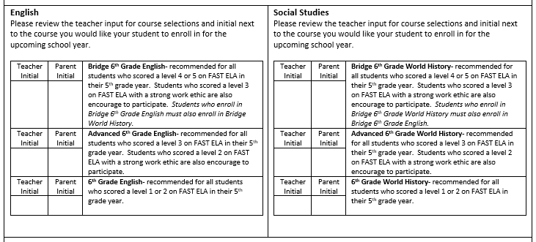

Slide 21
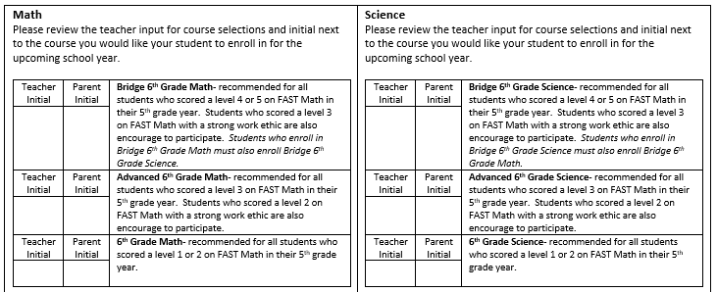

Slide 22
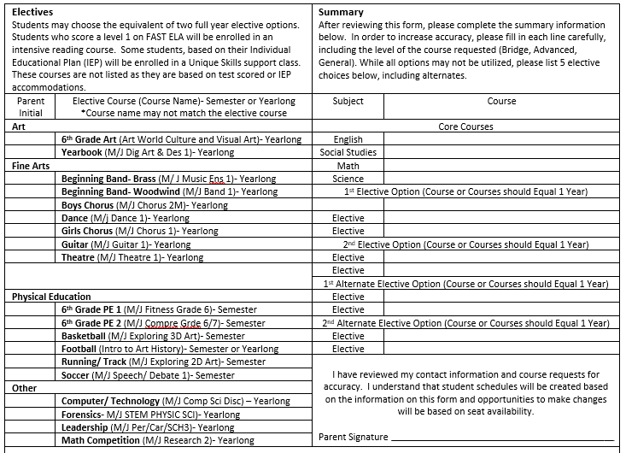

Slide 23
Questions?
Garrett Jahn- Assistant Principal, Curriculum jahng@leonschools.net
Matt Rousseau- Bridge Coordinator rousseaum@leonschools.net
Jenn Sabatelli- Bridge Coordinator sabatellij@leonschools.net
Jason Koerner- Principal koernerj2@leonschools.net

